Slide 1
Recovery System

Slide 2
Failure Classification
Transaction failure :
Logical errors: transaction cannot complete due to some internal error condition
System errors: the database system must terminate an active transaction due to an error condition (e.g., deadlock)
System crash: a power failure or other hardware or software failure causes the system to crash.
Fail-stop assumption: non-volatile storage contents are assumed to not be corrupted by system crash
Database systems have numerous integrity checks to prevent corruption of disk data
Disk failure: a head crash or similar disk failure destroys all or part of disk storage
Destruction is assumed to be detectable: disk drives use checksums to detect failures

Slide 3
Recovery and Atomicity (Cont.)
To ensure atomicity despite failures, we first output information describing the modifications to stable storage without modifying the database itself.
We study two approaches:
log-based recovery, and
shadow-paging
We assume (initially) that transactions run serially, that is, one after the other.

Slide 4
Log-Based Recovery
A log is kept on stable storage.
The log is a sequence of log records, and maintains a record of update activities on the database.
When transaction T_{i} starts, it registers itself by writing a <T_{i} start>log record
Before T_{i} executes write(X), a log record <T_{i}, X, V₁, V₂> is written, where V₁ is the value of X before the write, and V₂ is the value to be written to X.
Log record notes that T_{i} has performed a write on data item X_{j} X_{j} had value V₁ before the write, and will have value V₂ after the write.
When T_{i} finishes it last statement, the log record <T_{i} commit> is written.
We assume for now that log records are written directly to stable storage (that is, they are not buffered)
Two approaches using logs
Deferred database modification
Immediate database modification

Slide 5
Deferred Database Modification
The deferred database modification scheme records all modifications to the log, but defers all the writes to after partial commit.
Assume that transactions execute serially
Transaction starts by writing <T_{i} start> record to log.
A write(X) operation results in a log record <T_{i}, X, V> being written, where V is the new value for X
Note: old value is not needed for this scheme
The write is not performed on X at this time, but is deferred.
When T_{i} partially commits, <T_{i} commit> is written to the log
Finally, the log records are read and used to actually execute the previously deferred writes.

Slide 6
Deferred Database Modification (Cont.)
During recovery after a crash, a transaction needs to be redone if and only if both <T_{i} start> and<T_{i} commit> are there in the log.
Redoing a transaction T_{i} ( redoT_{i}) sets the value of all data items updated by the transaction to the new values.
Crashes can occur while
the transaction is executing the original updates, or
while recovery action is being taken
example transactions T₀ and T₁ (T₀ executes before T₁):
T₀: read (A) T₁ : read (C)
A: - A - 50 C:- C- 100
Write (A) write (C)
read (B)
B:- B + 50
write (B)

Slide 7
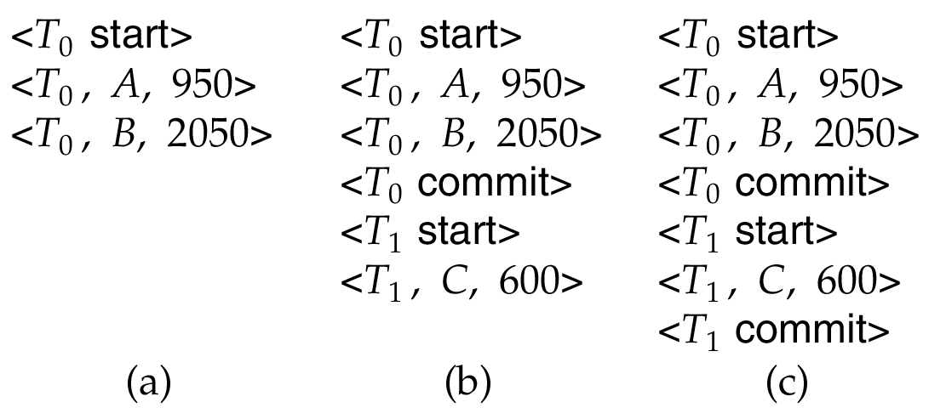
Deferred Database Modification (Cont.)
Below we show the log as it appears at three instances of time.
If log on stable storage at time of crash is as in case:
(a) No redo actions need to be taken
(b) redo(T₀) must be performed since <T₀ commit> is present
(c) redo(T₀) must be performed followed by redo(T₁) since
<T₀ commit> and <T_{i} commit> are present

Slide 8
Immediate Database Modification
The immediate database modification scheme allows database updates of an uncommitted transaction to be made as the writes are issued
since undoing may be needed, update logs must have both old value and new value
Update log record must be written before database item is written
We assume that the log record is output directly to stable storage
Can be extended to postpone log record output, so long as prior to execution of an output(B) operation for a data block B, all log records corresponding to items B must be flushed to stable storage
Output of updated blocks can take place at any time before or after transaction commit
Order in which blocks are output can be different from the order in which they are written.

Slide 9
Immediate Database Modification Example
x₁
Log Write Output
<T₀ start>
<T₀, A, 1000, 950>
T_{o}, B, 2000, 2050
A = 950
B = 2050
<T₀ commit>
<T₁ start>
<T₁, C, 700, 600>
C = 600
B_{B}, B_{C}
<T₁ commit>
B_{A}
Note: B_{X} denotes block containing X.

Slide 10
Shadow Paging
Shadow paging is an alternative to log-based recovery; this scheme is useful if transactions execute serially
Idea: maintain two page tables during the lifetime of a transaction –the current page table, and the shadow page table
Store the shadow page table in nonvolatile storage, such that state of the database prior to transaction execution may be recovered.
Shadow page table is never modified during execution
To start with, both the page tables are identical. Only current page table is used for data item accesses during execution of the transaction.
Whenever any page is about to be written for the first time
A copy of this page is made onto an unused page.
The current page table is then made to point to the copy
The update is performed on the copy

Slide 11
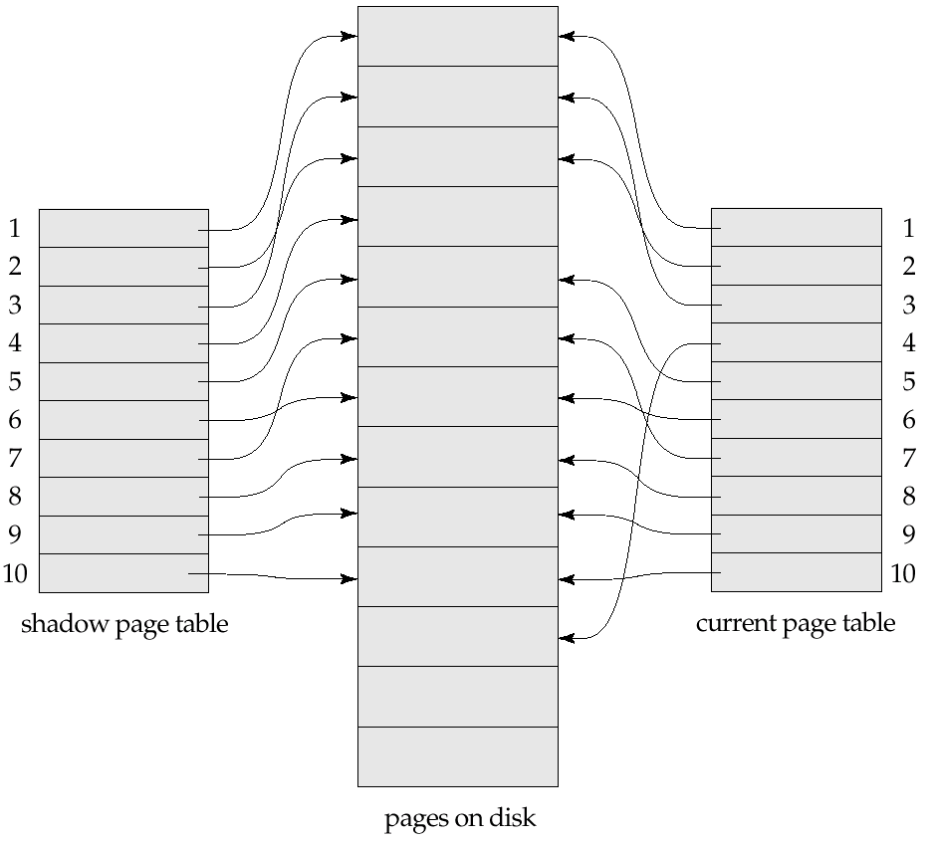
Example of Shadow Paging
Shadow and current page tables after write to page 4

